Slide 1

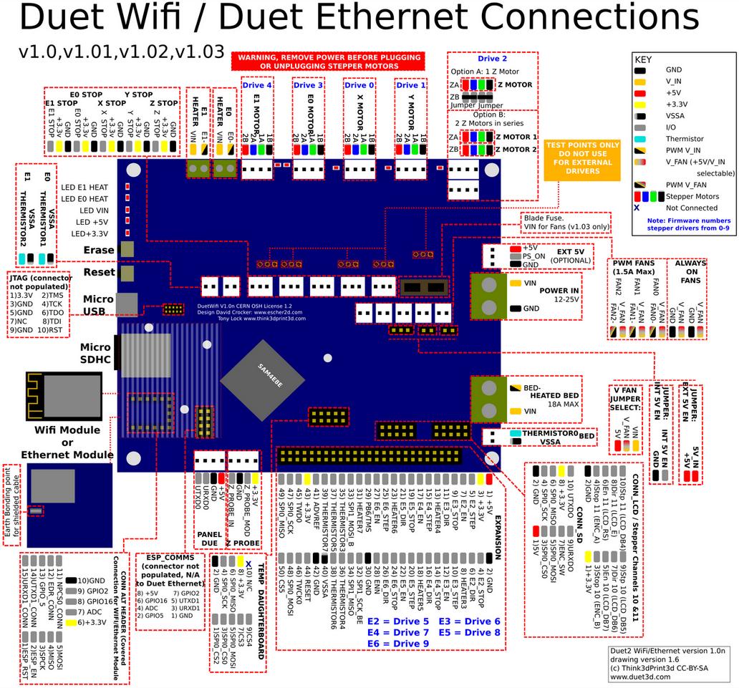
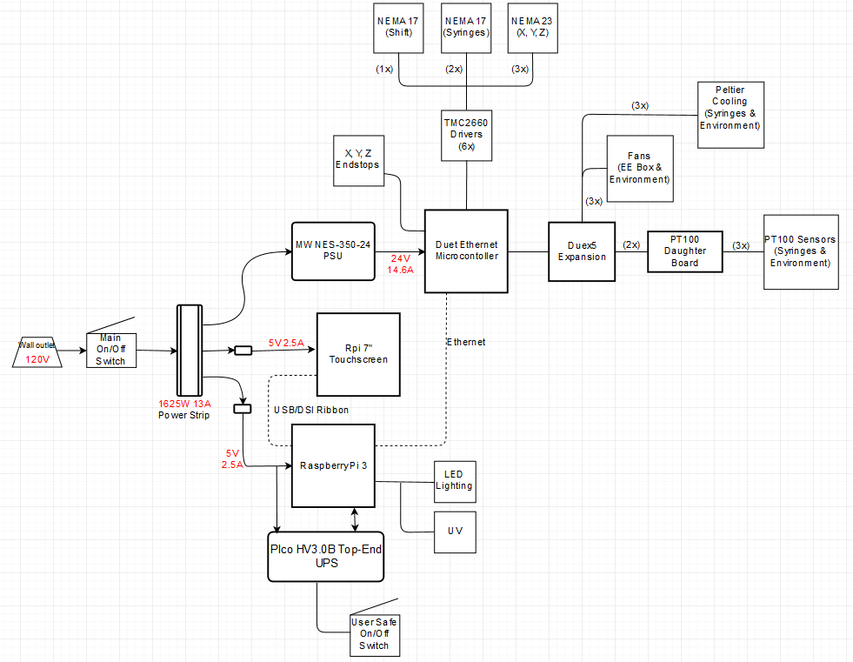
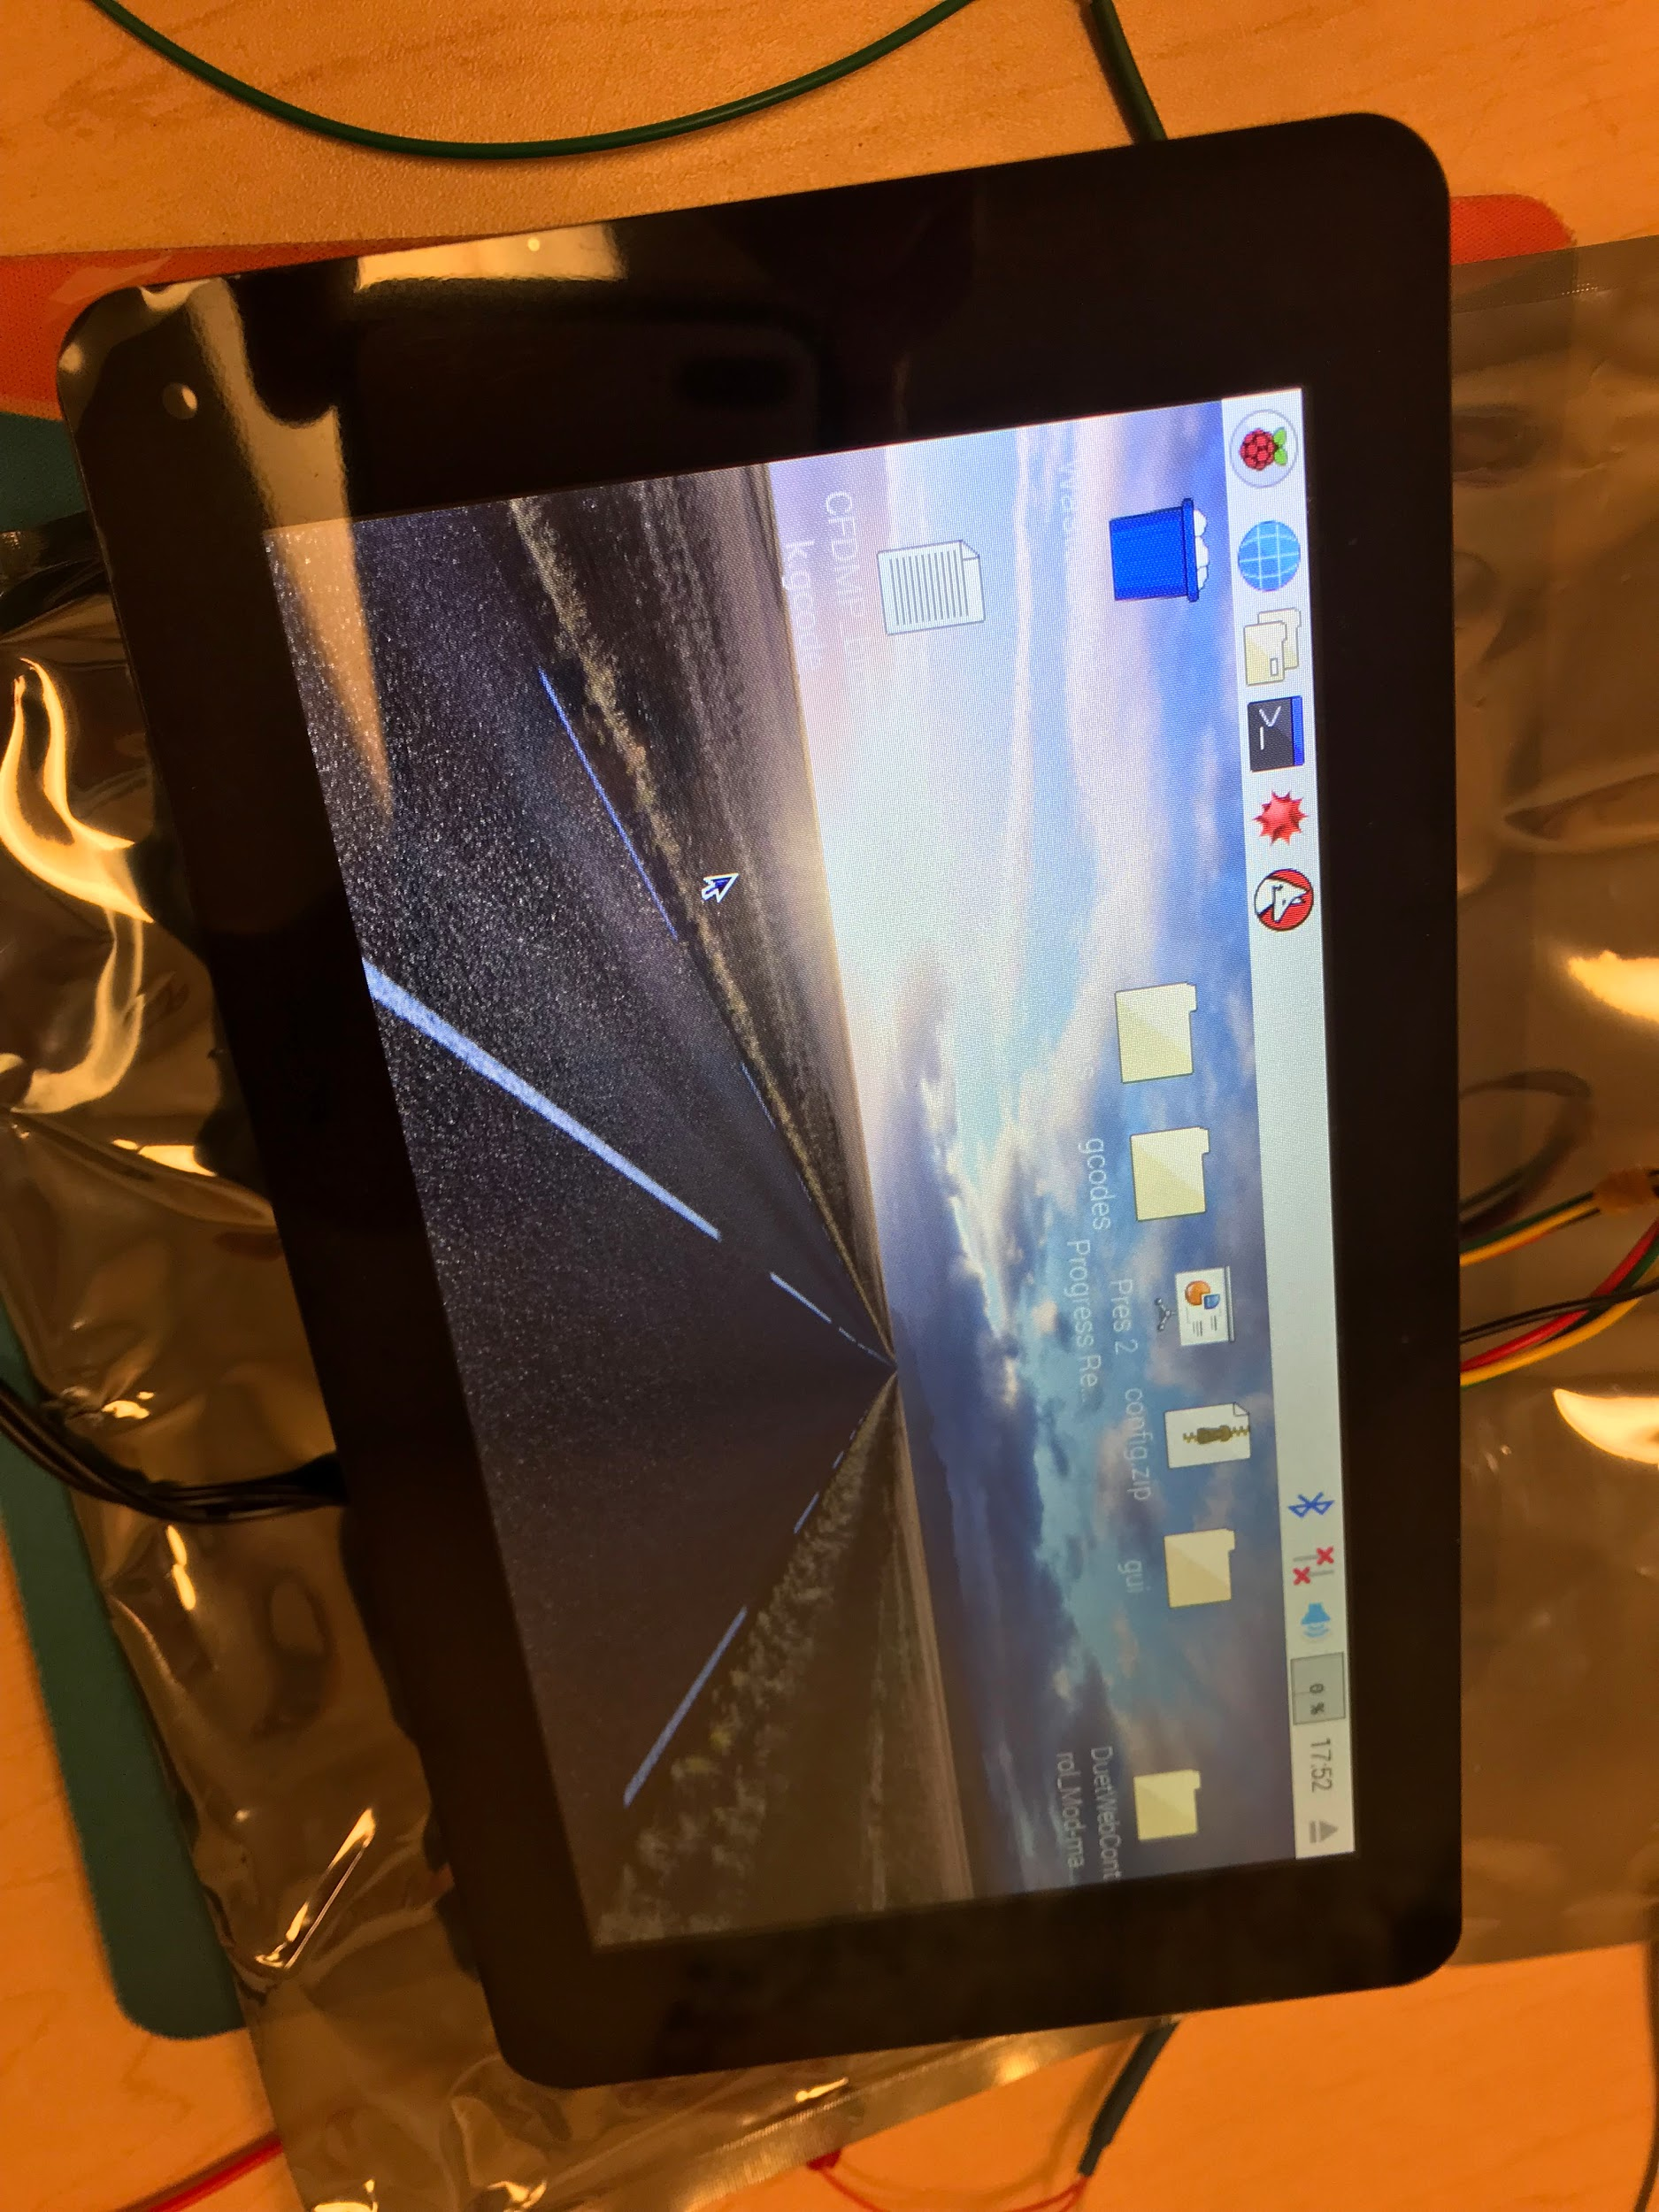
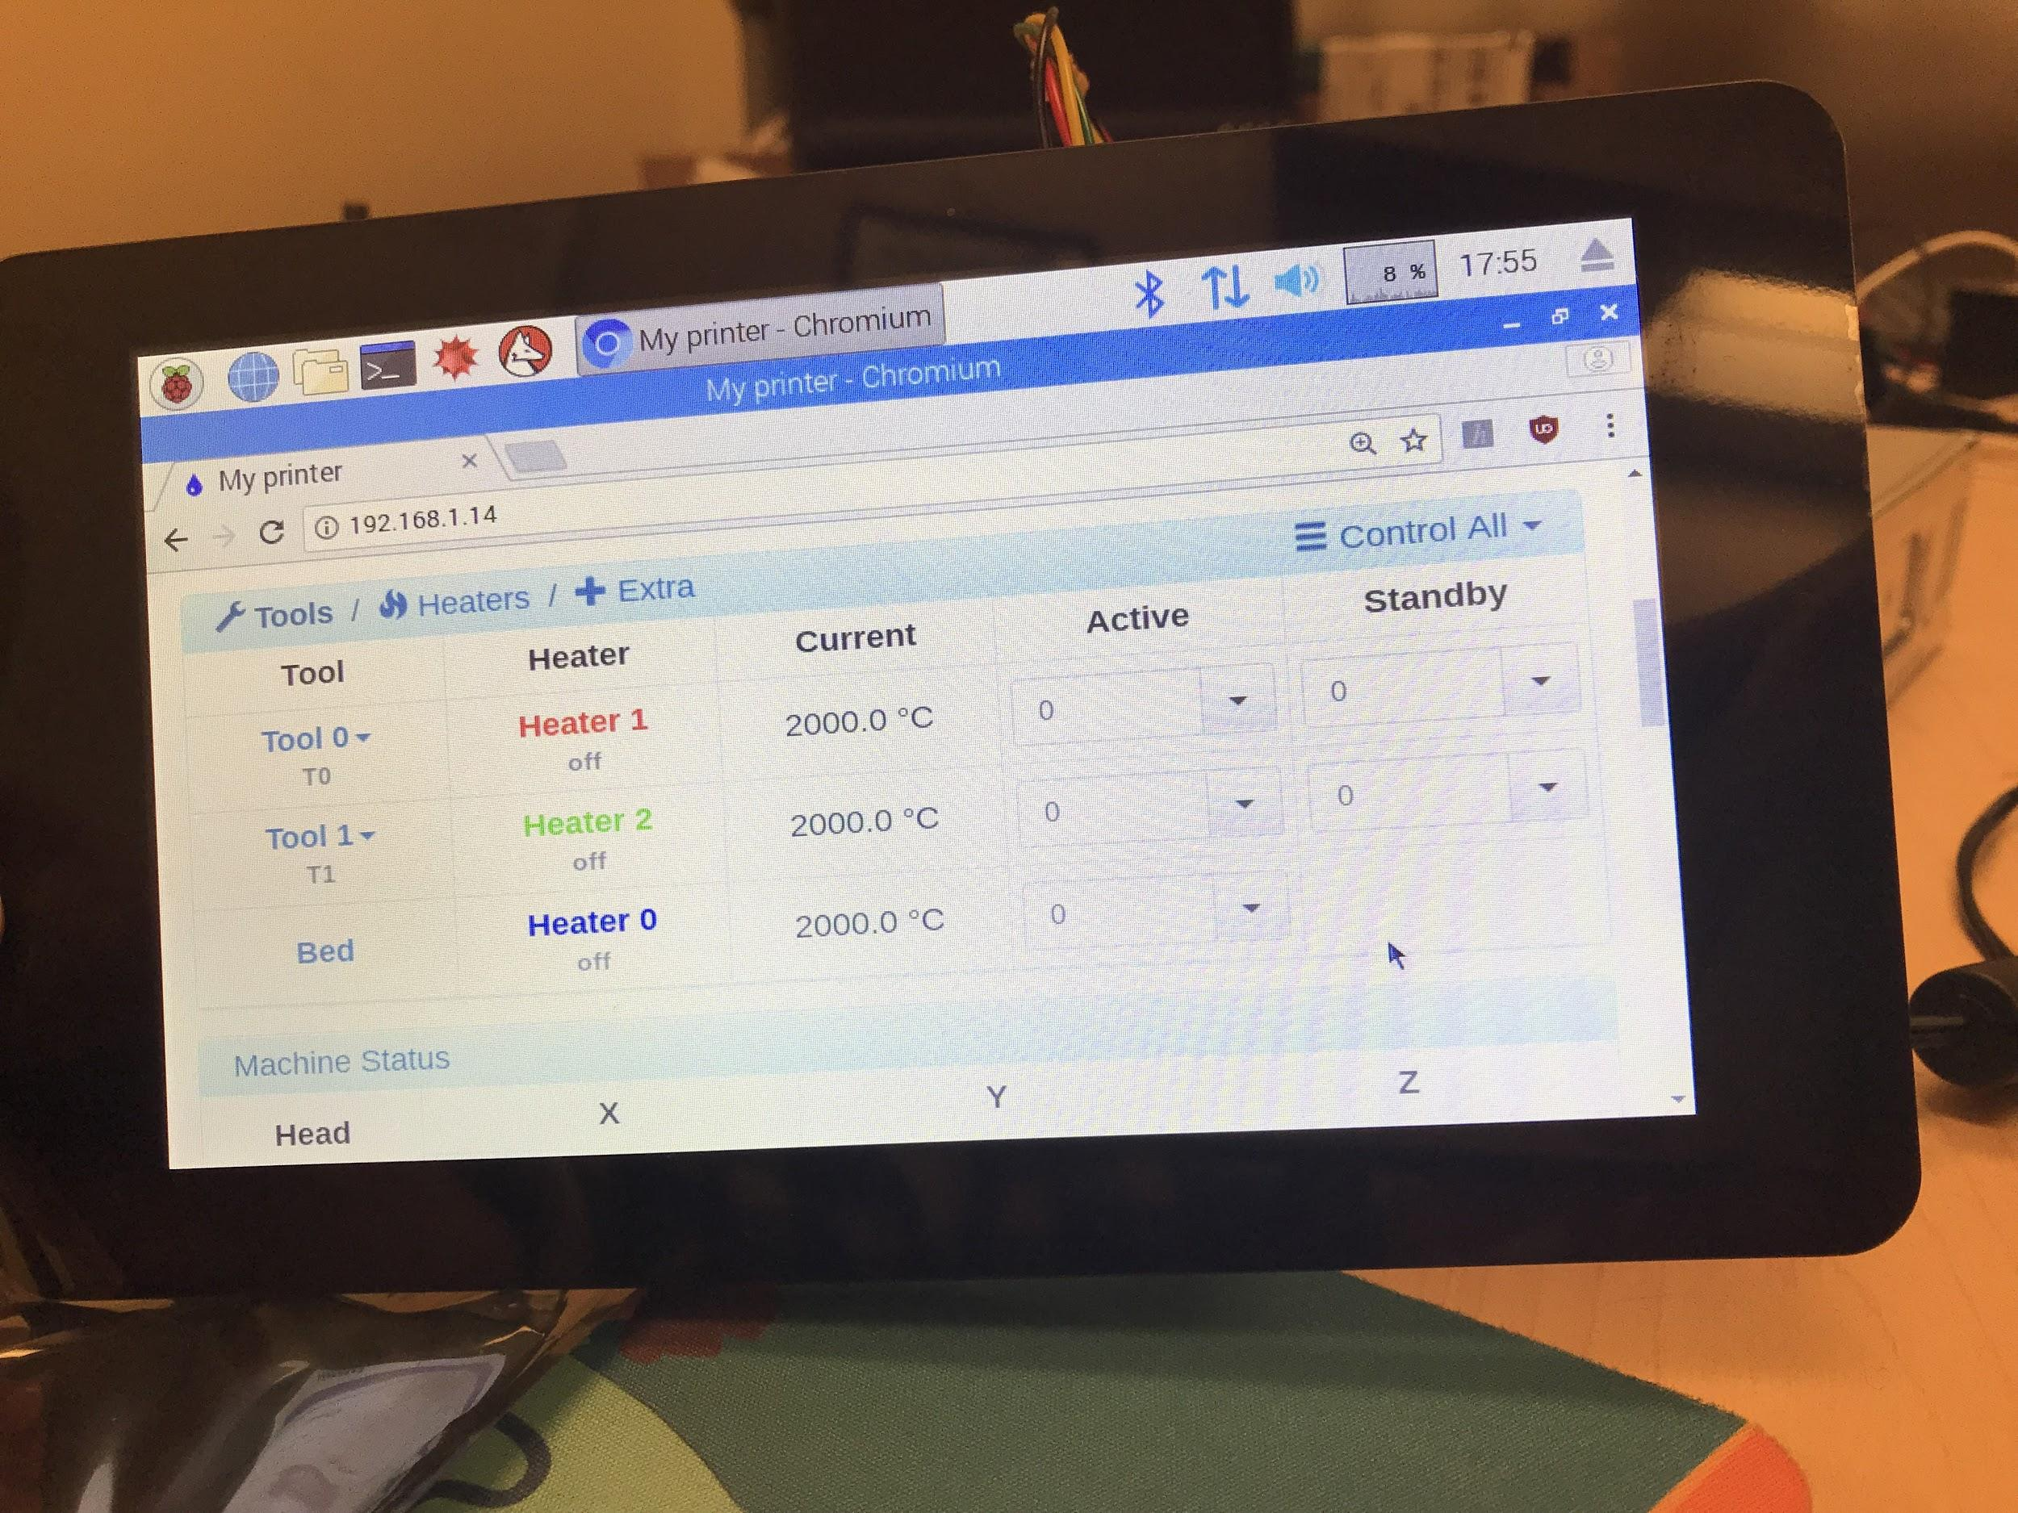
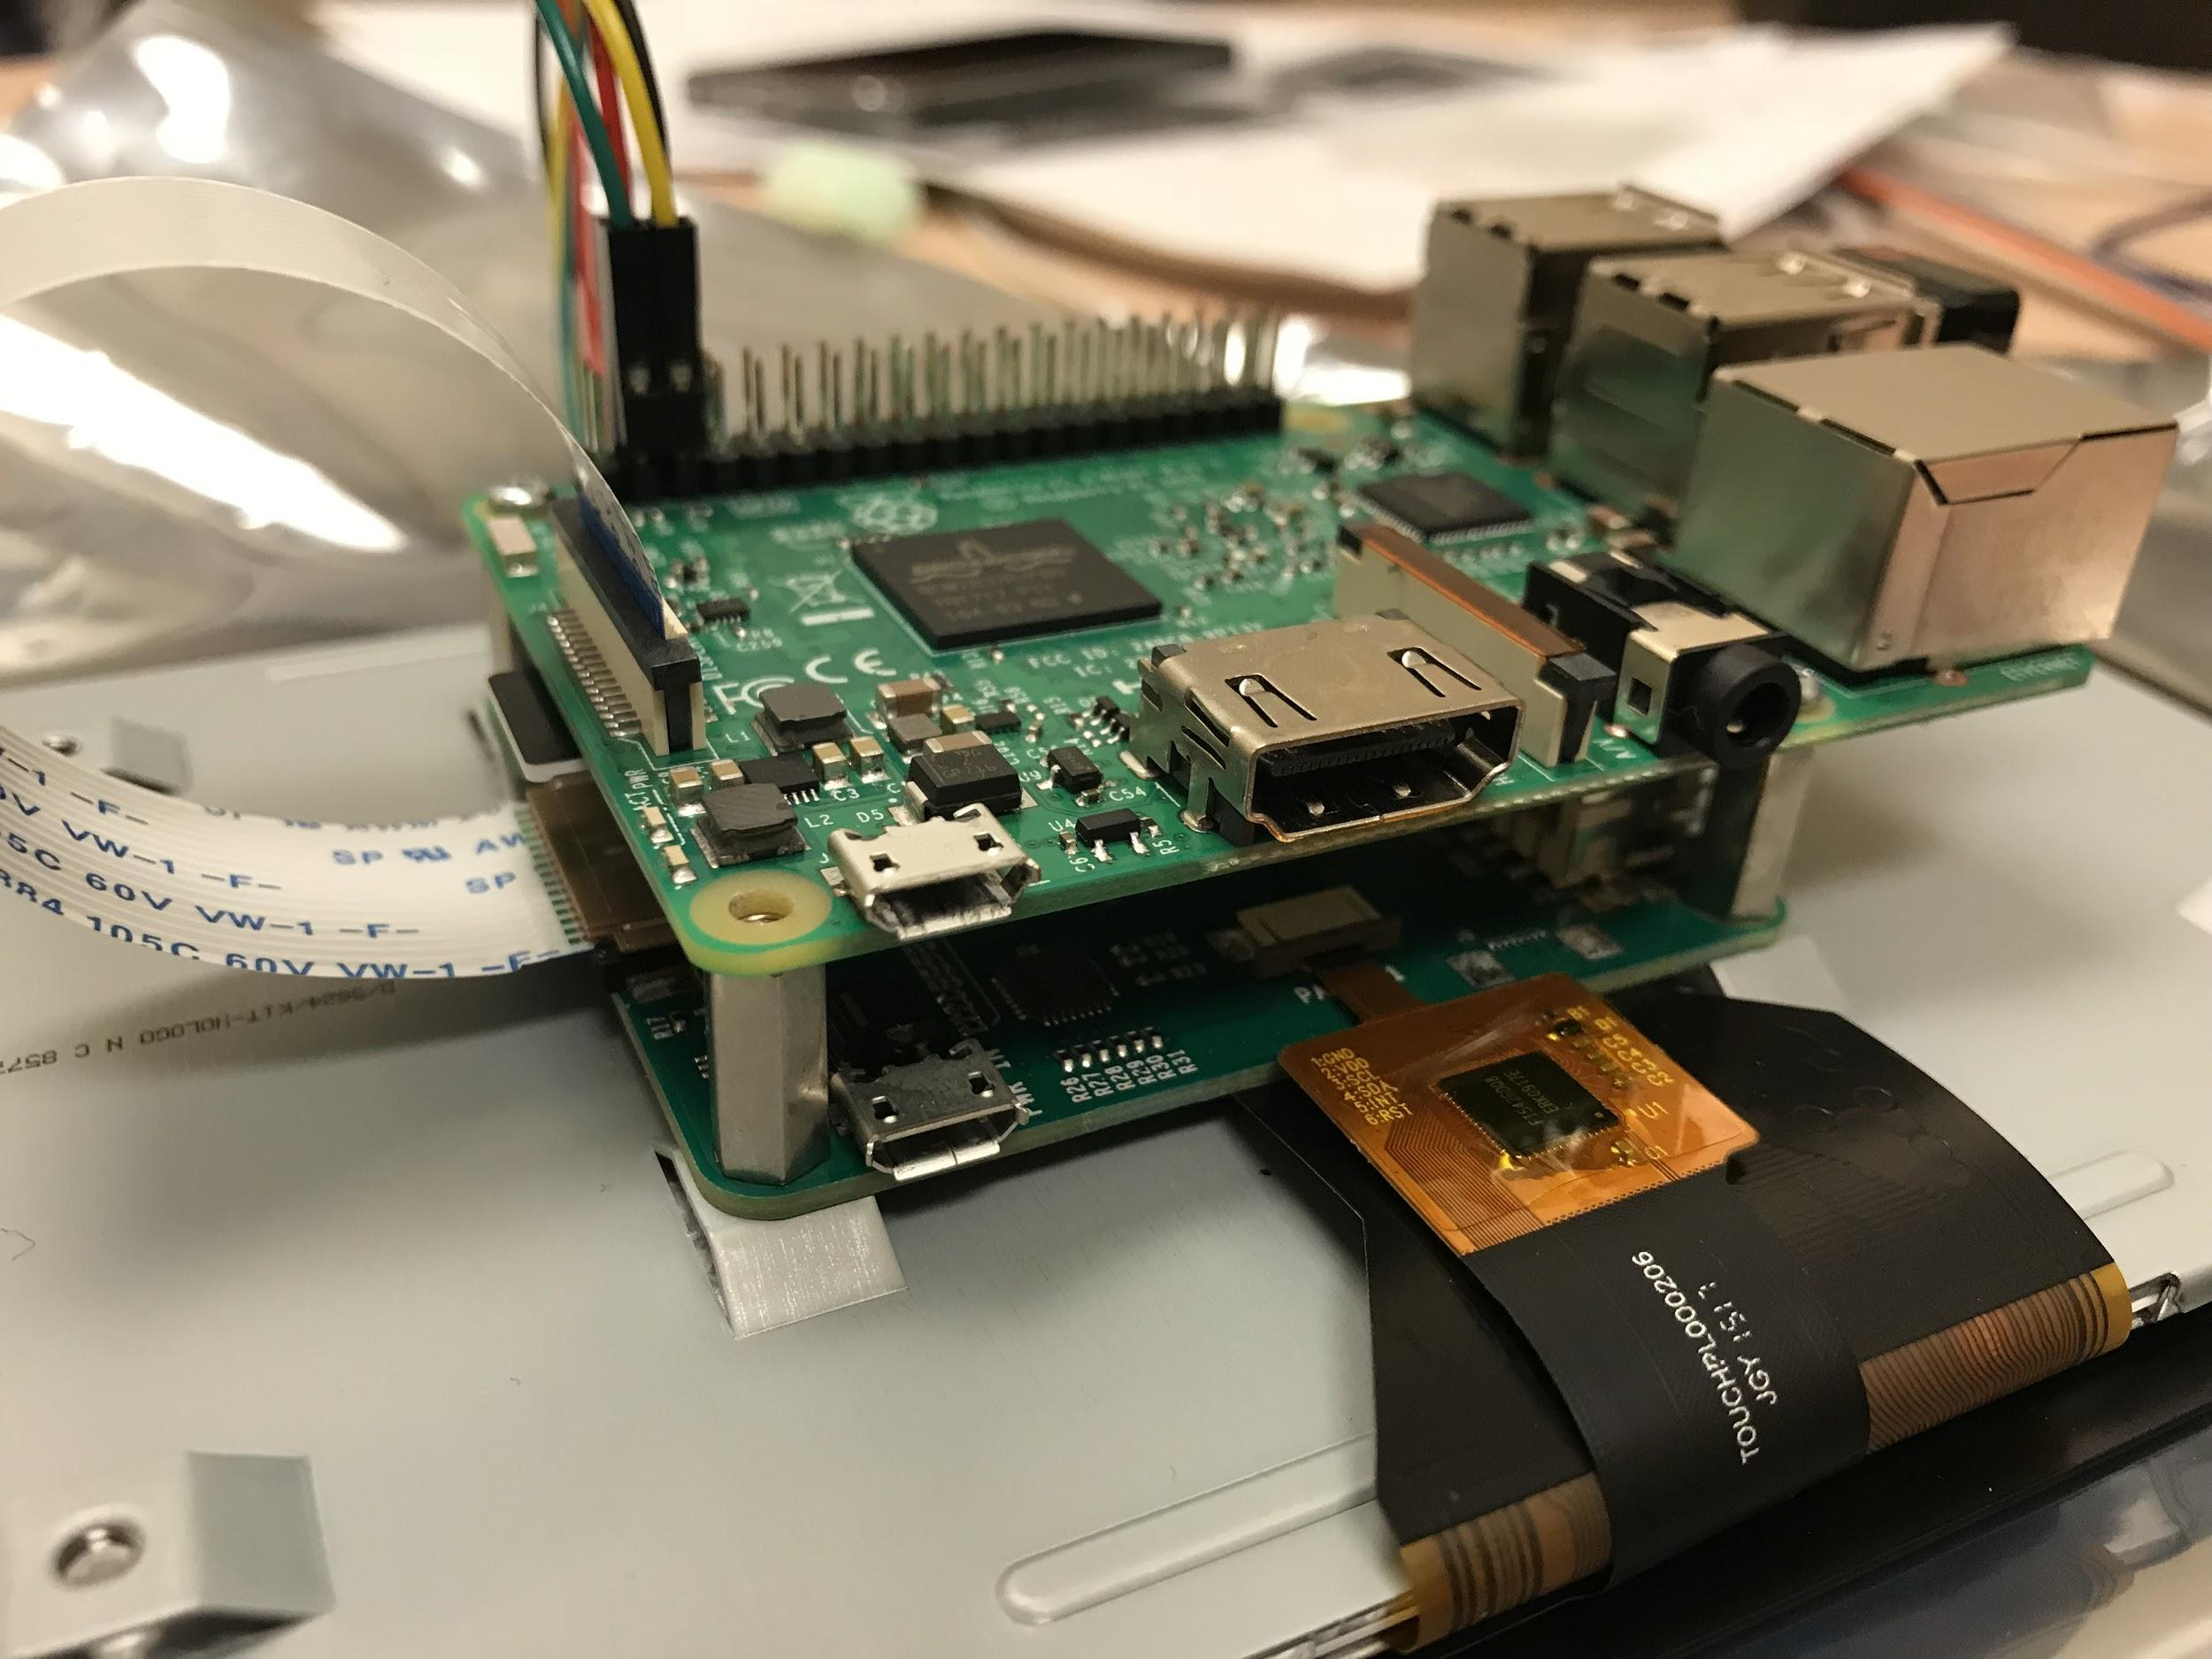
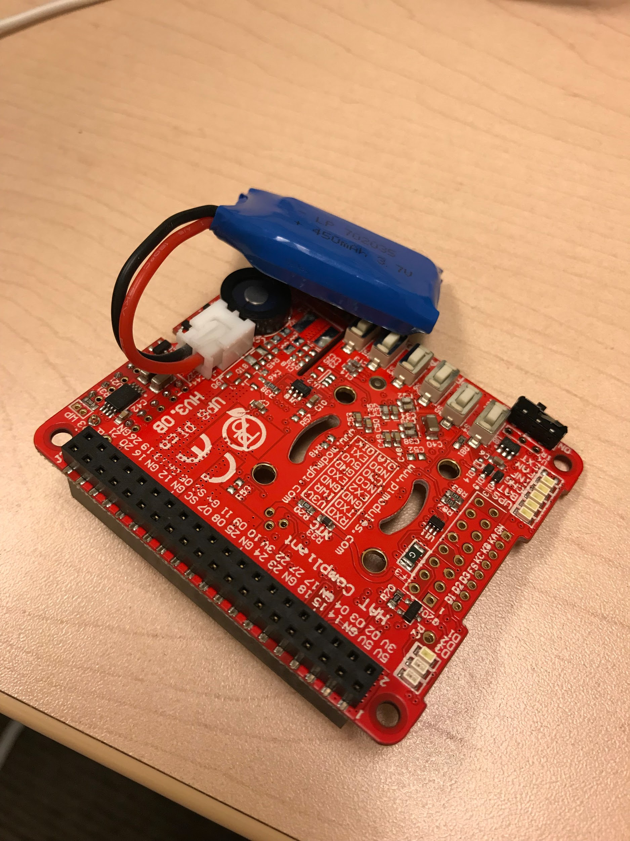
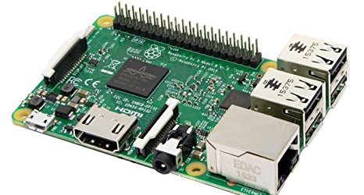
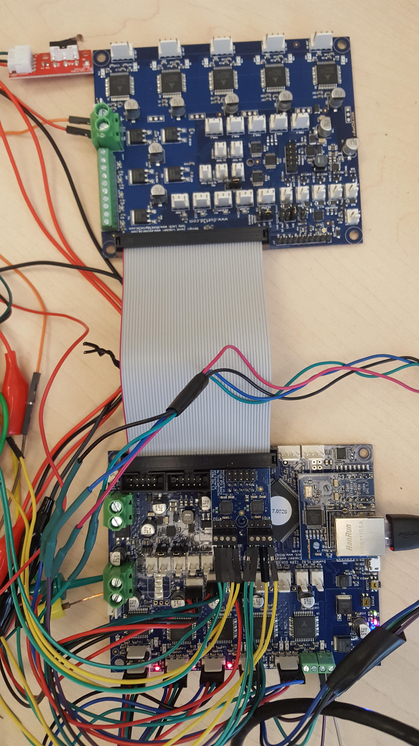
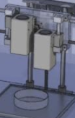
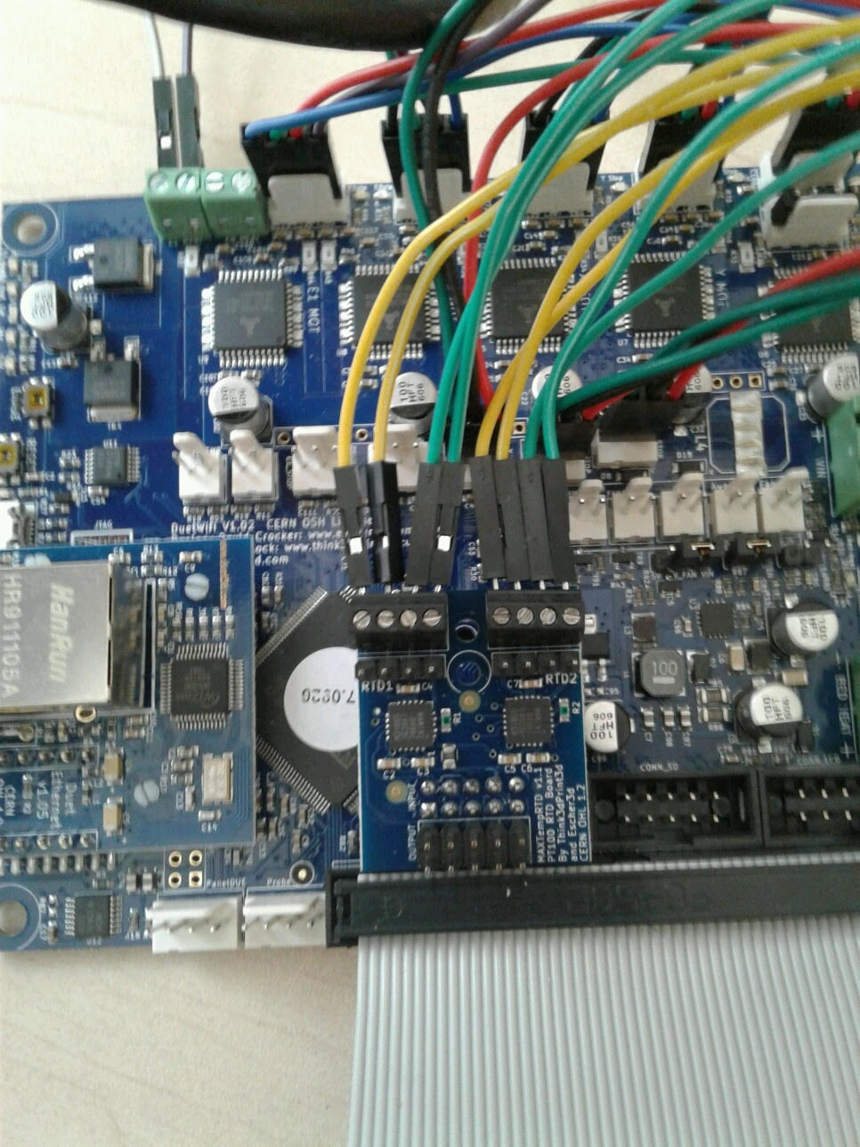
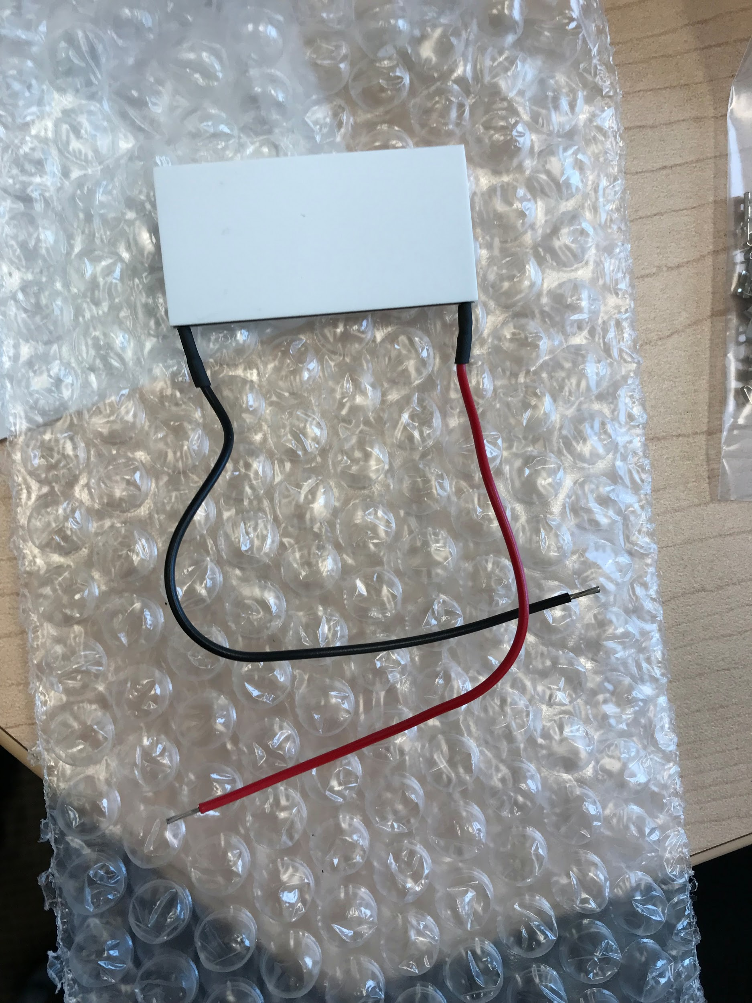
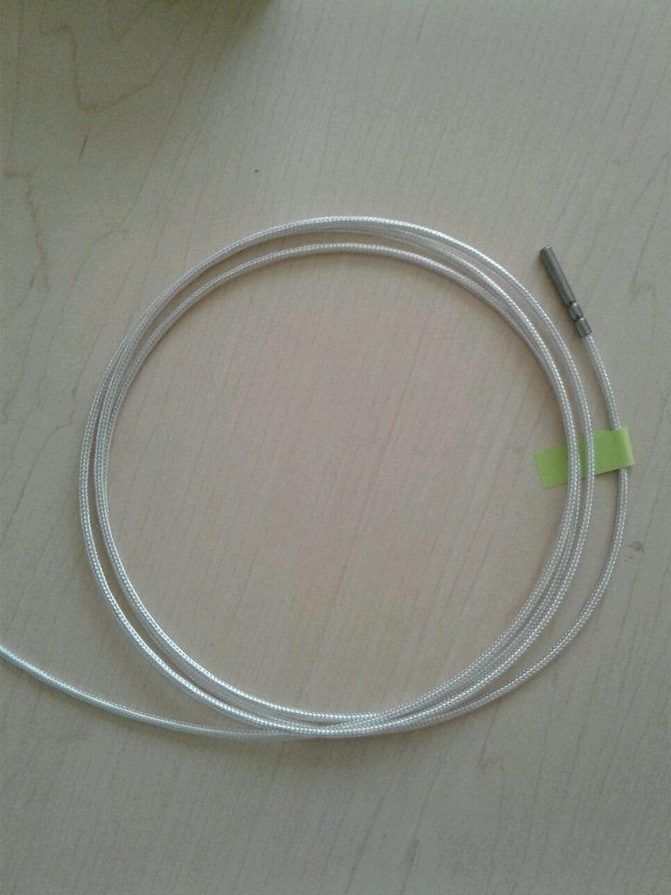
3D Bioprinter Hardware and Software
Electrical & Computer Engineering
Jacquelyn Chong, Marc Abou Jaoude, Samuel Bland, Shervin Zoghi
Advisors: Dr. Nan Wang
Abstract
Microcontroller
Design
The gap between engineering and the medical field is being bridged with the technological advancements of bioprinting. Bioprinting uses the concepts of regular 3D printing and applies them to be able to print cells. This bioprinting technology has the potential to create patient-specific tissue all the way to whole organs for medical and research purposes. The team consists of mechanical engineers, ME’s, and electrical engineers, EE’s. The ME team focused on the physical design while the EE team designed the electrical circuits and the program for the printer. The program for the printer includes a tailored firmware that allows the printer to recognize and print the user-designed model through a customized user interface. The purpose of this project is to create a working prototype of a 3D bioprinter that can be marketed as a more economic alternative.
Duet Ethernet
Atmel SAM4E8E 120MHz ARM 32 Bit Processor
TMC2660 Stepper drivers up to 256 microstepping
On-the-fly firmware tweaking and editing
3x PWM and 2x always-on fans/LED’s
24V or 12V power
Ethernet module for communication and networking
Output current for motor is 2.4A and for bed/environment is 18A
Expandable with Duex5 board
https://duet3d.dozuki.com/Wiki/Duet_Wiring_Diagrams
User Interface
RaspberryPi
A 7” Raspberry touchscreen display is used for a simplified user interface, shown at the bottom-left. The Pi is mounted to the touch screen's processor board on the back and connected with a ribbon and wires, shown in the bottom-middle. The touchscreen allows the user to communicate with the printer. Through the touchscreen, the user is able upload the models and initiate the printing of the selected model. The models are uploaded and printed on the Duet Web Control, DWC, shown in the bottom-right. The existing DWC is modified in order to create a clean, straightforward interface for the user. The simplified version allows the user to upload, start, monitor, pause, and stop the print with ease.
The nature of 3D printers is embedded systems. With a Pi, the printer will have the ability to expand its functions and capabilities; the Pi provides the potential for future add-ons such as a live-feed camera, data processing and analysis, etc. However, with the Pi in the system running an OS, Raspbian, the standard power ON/OFF switch was problematic due to the possibility of corrupting the OS. The solution was to emulate the simplicity of embedded systems by attaching the Pi to a UPS, an intelligent battery backup system which detects loss of power and begins the shutdown process of the Pi in the standard procedure.
Communication
To prepare for future improvements and expansion, the Duet Ethernet is dedicated to handling the entire printing process while human interfacing is managed through the Raspberry Pi. In order to relay information between the Duet and Pi, an ethernet connection is established. Using the unique IP address and appropriate LAN connection, HTTP commands are sent for control and feedback of the two devices. With the addition of an expansion board, the Duex 5 is connected to the Duet Ethernet with a 50 pin ribbon to the Duet Ethernet.
Duex 5
Syringe Shift
Heating & Temperature Control
Sponsor/Conclusion
The printer is designed to have the potential for future expansion; the Duex 5 expansion board is implemented with that in mind. The expansion board allows for additional stepper motor drivers, GPIO’s, controlled fans, etc. for the next phases of this project. Shown to the left, the Duex 5 expansion board is connected with a ribbon to the main Duet Ethernet board.
In order to create 3D bio-models, two layers need to be printed: the structure layer and then an embedded cell layer. To prevent the previous syringe from interfering with the print, a unique mechanism is designed for shifting each syringe after the layer has been finished. The syringes create a “see-saw” motion; one syringe is retracted when the other is lowered. This is implemented through a unique code file that caters to this specific design.
Dealing with highly sensitive printing material, a homeostatic environment is needed for the preservation of the print. To maintain the environment’s temperature, the design uses 4-wire PT100 sensors which is shown in the bottom-left. PT100 sensors are highly precise and offers identical performances. The sensors are connected through the PT100 daughterboard; the daughter board is then mounted onto the Duet Ethernet. The bottom right shows the peltier unit which will be used for heating to the desired temperature.
Sponsor: Shervin Zoghi
The 3D Bioprinter is designed and constructed to:
maintain homeostatic environment for printing material
implement syringe shifting mechanism within unique code
create a simplified, user friendly interface
have the potential for further expansion
2018

